Slide 1


Module 6: Common Questions and Answers (Q&A) for Vaccine Champions

Slide 2
Common Questions
This module will cover questions that you may encounter as a Vaccine Champion, and provides sample answers for these questions. Many deal with common points of mis/dis/mal-information.

Slide 3
Q. If I had COVID-19 or Influenza before, should I still get vaccinated?
Yes, you should still get vaccinated if you have been infected previously. The vaccines give you longer-lasting protection than the immunity gained from infection, so it is recommended that you still receive the vaccines.^{1,3,4}
Notes:
1. https://www.canada.ca/en/public-health/services/diseases/coronavirus-disease-covid-19/vaccines/how-vaccinated.html
3. https://www.hopkinsmedicine.org/health/conditions-and-diseases/coronavirus/covid-19-vaccine-what-you-need-to-know
4. https://www.canada.ca/en/public-health/services/publications/healthy-living/canadian-immunization-guide-part-4-active-vaccines/page-26-covid-19-vaccine.html

Slide 4
Q. Why can I still get infected with COVID-19 after I get vaccinated? Does that mean the vaccines don’t work?
Becoming infected after being vaccinated is known as a “breakthrough infection” and can happen for different reasons, like contracting a variant not covered in the vaccine, waning protection, or not having enough time to build immunity post-vaccine.⁵
Notes:
5. http://web.archive.org/web/20240828205445/https://www.idsociety.org/covid-19-real-time-learning-network/vaccines/what-is-a-breakthrough-infection/#/+/0/publishedDate_na_dt/desc/

Slide 5
Q. Why can I still get infected with COVID-19 after I get vaccinated? Does that mean the vaccines don’t work? (Continued)
Research shows that being vaccinated against the virus significantly reduces your chances of developing serious outcomes from COVID-19 (including hospitalization or death) than if you hadn’t been vaccinated.^{5,6}
All approved vaccines in Canada have been determined to be safe and significantly effective against COVID-19, and its variants.⁷
Notes:
5. http://web.archive.org/web/20240828205445/https://www.idsociety.org/covid-19-real-time-learning-network/vaccines/what-is-a-breakthrough-infection/#/+/0/publishedDate_na_dt/desc/
6. http://web.archive.org/web/20250801235519/https://www.myhealthunit.ca/en/health-topics/covid-19-vaccine-vaccination-frequently-asked-questions.aspx#What-is-the-COVID-19-vaccine
7. https://www.canada.ca/en/public-health/services/diseases/coronavirus-disease-covid-19/vaccines/how-vaccinated.html

Slide 6

Q. Can I get a COVID-19 or Influenza infection from the vaccine?
The vaccines help protect you from COVID-19 or Influenza infection, and will not infect you with COVID-19 or Influenza. The types of vaccines available in Ontario do not contain the live virus, and so they cannot cause infection.^{9,10,12}
Notes:
9. https://www.healthlinkbc.ca/healthlinkbc-files/inactivated-influenza-flu-vaccine
10. http://web.archive.org/web/20241208112615/https://www.publichealthontario.ca/-/media/Documents/V/2023/vaccines-influenza-season.pdf
12. http://web.archive.org/web/20250806235419/https://health-infobase.canada.ca/covid-19/vaccine-safety/

Slide 7
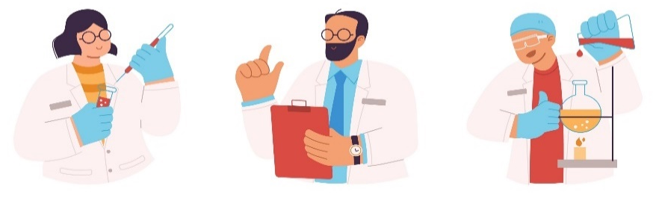
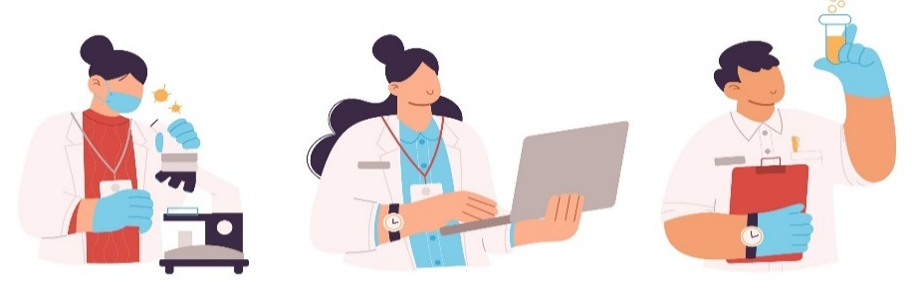
Q. How common are serious adverse events (side effects) from the COVID-19 vaccine?
The COVID-19 vaccine has been tested rigorously, and evidence shows that it is safe. Most side effects are mild, such as fatigue, a sore arm, or headache.¹³
Serious side effects from the COVID-19 vaccine are rare, occurring in only about 1 out of every 10,000 vaccinations in Canada.¹² Most of these serious adverse events are treatable, and many are much more common after COVID-19 infection than after vaccination.
Notes:
12. https://health-infobase.canada.ca/vaccination/adverse-events/
13. https://www.canada.ca/en/public-health/services/diseases/coronavirus-disease-covid-19/vaccines/safety-side-effects.html

Slide 8
Q. How common are serious adverse events (side effects) from the COVID-19 vaccine? (Continued)
For example, severe allergic reactions are only seen in 1 per 100,000 COVID-19 vaccinations in Canada¹² and are treatable. You are asked to stay at the vaccination site for a few minutes to make sure any reaction can be treated right away.
Other potential complications, such as inflammation of the heart muscle or outer lining, face weakness, or paralysis, are also rare and generally go away with medical treatment.¹²
Notes:
12. http://web.archive.org/web/20250806235419/https://health-infobase.canada.ca/covid-19/vaccine-safety/

Slide 9
Q. Why is the AstraZeneca COVID-19 vaccine no longer offered in Canada?
Approximately 4 in every 100,000 people vaccinated with AstraZeneca experienced blood clots following vaccination. Blood clots are a treatable but serious adverse reaction.^{15,16}
Because the adverse reaction was so rare, it was not found in clinical trials and so was not expected. Provincial governments put restrictions on who could get the AstraZeneca vaccine while Health Canada investigated these cases.¹⁵ With low demand, the pharmaceutical company stopped producing the vaccine.^{17,18}
It is important to note that, like many other of the reported side effects for the COVID-19 vaccines, blood clots are more common after infection than vaccination.^{19,20}
Notes:
15. https://recalls-rappels.canada.ca/en/alert-recall/health-canada-issues-label-change-astrazeneca-and-covishield-covid-19-vaccines
16. https://www.canada.ca/en/public-health/services/immunization/national-advisory-committee-on-immunization-naci/rapid-response-recommended-use-astrazeneca-covid-19-vaccine-younger-adults.html
17. https://www.thecanadianpressnews.ca/fact_checking/astrazeneca-cites-weak-demand-not-side-effects-as-reason-for-withdrawing-covid-19-vaccine/article_8af5457a-b74c-5fdb-91dd-61c9ad285c10.html
18. https://www.canada.ca/en/health-canada/services/drugs-health-products/covid19-industry/drugs-vaccines-treatments/vaccines/astrazeneca.html
19. https://www.thelancet.com/journals/laninf/article/PIIS1473-3099(22)00314-0/fulltext
20. https://bmcneurol.biomedcentral.com/articles/10.1186/s12883-025-04041-7

Slide 10

Q. How common are serious adverse reactions (side effects) from the Influenza vaccine?
The Influenza vaccine has been tested rigorously, and evidence shows that it is safe. Most people experience mild (e.g., headache, fatigue) to no side effects from the vaccine.^{9,21,22}
Fewer than 5 in 100 people may experience red eyes and a cough or sore throat after an Influenza vaccine.²³
Notes:
9. https://www.healthlinkbc.ca/healthlinkbc-files/inactivated-influenza-flu-vaccine
21. https://www.toronto.ca/community-people/health-wellness-care/health-programs-advice/immunization/flu-influenza-vaccines/
22. https://www.canada.ca/en/public-health/services/diseases/flu-influenza/get-your-flu-shot.html
23. https://web.archive.org/web/20220109205928/https://www.canada.ca/en/public-health/services/reports-publications/canada-communicable-disease-report-ccdr/monthly-issue/2004-30/safety-revaccination-patients-affected-oculo-respiratory-syndrome-following-influenza-vaccination.html

Slide 11
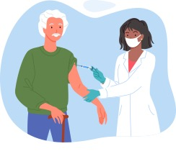
Q. Does the Influenza vaccine lead to serious side effects? (Continued)
Serious side effects from the vaccine, like allergic reactions, are rare.²⁴
Guillain-Barré Syndrome (GBS) only occurs in 1-2 out of 1 million Influenza vaccinations. You are more likely to get GBS after being infected with Influenza than you are after getting vaccinated.³⁶
Notes:
24. https://www.toronto.ca/community-people/health-wellness-care/health-programs-advice/immunization/flu-influenza-vaccines/
36. https://www.thelancet.com/journals/laninf/article/PIIS1473-3099(13)70104-X/abstract

Slide 12
Q. Can the mRNA COVID-19 vaccine alter my DNA?
The vaccine cannot change your DNA. mRNA provides your body with instructions to create harmless proteins or virus pieces that trigger the creation of antibodies, which will attack the COVID-19 virus if you are exposed.
The mRNA from the vaccine is never in the same location as your DNA, and after the antibodies are created, your body will get rid of all of the vaccine ingredients.²⁵
Notes:
25. https://www.canada.ca/en/health-canada/services/drugs-health-products/covid19-industry/drugs-vaccines-treatments/vaccines/type-mrna.html

Slide 13
Q. Is it safe for me to get vaccinated if I am pregnant or breastfeeding? Will it affect my fertility?
A. Getting the COVID-19 and/or Influenza vaccine while pregnant or breastfeeding is safe for both you and the child. Getting vaccinated will help protect you from hospitalization due to infection, which also helps to protect your child.^{26,27}
Getting the vaccines during pregnancy can also protect your baby from infection after birth through shared antibodies. This protection also comes from breastfeeding after vaccination.²⁸
Notes:
26. http://web.archive.org/web/20250801044311/http://www.bccdc.ca/health-info/diseases-conditions/covid-19/covid-19-vaccine/vaccine-considerations
27. https://www.ontario.ca/page/covid-19-vaccines#pregnant
28. https://www.canada.ca/en/public-health/services/immunization-vaccines/vaccination-pregnancy-covid-19.html#a1

Slide 14
Q. Is it safe for me to get vaccinated if I am pregnant or breastfeeding? Will it affect my fertility? (Continued)
Neither vaccine has been shown to have any negative effects on fertility. In fact, the COVID-19 VIRUS is associated with increased risk of erectile dysfunction,²⁹ which negatively impacts male fertility, and increased risk of premature births.³⁰
The best way to protect people who are pregnant, trying to get pregnant, or concerned about fertility is to get vaccinated against the COVID-19 virus and prevent infection.²⁶
Notes:
26. http://web.archive.org/web/20250801044311/http://www.bccdc.ca/health-info/diseases-conditions/covid-19/covid-19-vaccine/vaccine-considerations
29. https://health.clevelandclinic.org/yes-covid-19-can-cause-erectile-dysfunction
30. https://www.nih.gov/news-events/nih-research-matters/impact-covid-19-infections-vaccines-preterm-birth

Slide 15
Q. Is the vaccine permitted and recommended for those practicing different religions and who are from different communities within Canada?
A. Many North American faith-based communities recommend or permit vaccination. Among these are:
    The Canadian Muslim COVID-19 Task Force (CMTF);³¹
    The Orthodox Union and Rabbinical Council of America;³²
    the United States Conference of Catholic Bishops;³³
    and the Hindu American Foundation.³⁴
Notes:
31. https://cmcovidtf.com/post/statement-regarding-covid-19-vaccines
32. https://www.ou.org/assets/Guidance-re-Vaccines.pdf
33. http://web.archive.org/web/20250713135104/https://www.usccb.org/moral-considerations-covid-vaccines
34. https://www.hinduamerican.org/press/india-covid-relief-solidarity-act-passes-house

Slide 16
Q. Do the COVID-19 vaccines contain any animal products? Are they Halal/Kosher?
A. As of 2025, the COVID-19 vaccines that are available in Canada are all Halal, Kosher, and do not contain any animal products.⁷
For a full list of ingredients found in each of the approved vaccines, please visit the Health Canada website here: COVID-19 Vaccines: Authorized vaccines - Canada.ca
Notes:
7. https://www.canada.ca/en/public-health/services/diseases/coronavirus-disease-covid-19/vaccines/how-vaccinated.html
Full list of ingredients in each of the approved vaccines: https://www.canada.ca/en/health-canada/services/drugs-health-products/covid19-industry/drugs-vaccines-treatments/vaccines.html

Slide 17
Q. Can I get the vaccine even if I have bad allergies or asthma?
A. Having asthma or allergies (food, environmental, medication, etc.) does not mean you should not get the COVID-19 vaccine.³⁵
If you are allergic to one of the vaccine components, like polyethylene glycol (PEG) or polysorbate, it is recommended that you consult an allergist regarding getting vaccinated against COVID-19.¹
The allergist may arrange graded vaccine administration, where the vaccine is given in smaller doses spread out over time.³⁵
Notes:
35. https://www.youtube.com/watch?v=vWFh9x_8K4c
1. https://www.canada.ca/en/public-health/services/diseases/coronavirus-disease-covid-19/vaccines/how-vaccinated.html

Slide 18
Additional Supports
If you would like to download a copy of these common Q&As, see the Common Questions & Answers for Vaccine Champions resource.
The next module will provide you with a list of resources that may be useful in your role as a Vaccine Champion.
Notes:
Common Questions & Answers for Vaccine Champions: https://wellness-hub.ca/res/common-questions-answers-for-vaccine-champions/

Slide 19
Key Takeaways
There’s a lot of misconceptions and misinformation surrounding vaccines and vaccines safety, which can lead to a lot of questions!
Keeping these factual responses to common questions can help you correct any misconceptions that people may ask you about.

