Slide 1


Module 4: Recent Vaccination Trends

Slide 2
Common Questions about Getting Vaccinated

Slide 3

Who is at a higher risk from COVID-19 and Influenza?
These groups are at increased risk of infection or severe illness from COVID-19^{1,2} and/or Influenza:^{3,4,5}
 | Group | Influenza | COVID-19
 | People 65 years of age and older | ✓ | ✓
 | People with certain underlying health conditions, including those who are immunocompromised | ✓ | ✓
 | People who are pregnant or recently pregnant | ✓ | ✓
 | Residents and staff of long-term care homes or other group living settings | ✓ | ✓
 | Indigenous peoples | ✓ | ✓
Notes:
1. https://publications.gc.ca/collections/collection_2026/aspc-phac/HP40-376-2026-eng.pdf
2. https://www.canada.ca/en/public-health/services/diseases/coronavirus-disease-covid-19/vaccines/how-vaccinated.html
3. https://www.canada.ca/en/public-health/services/diseases/flu-influenza/prevention-risks.html
4. https://www.ontario.ca/page/universal-Influenza-immunization-program#section-2
5. http://web.archive.org/web/20250223114153/https://immunizebc.ca/vaccines/Influenza#Who%20should%20get%20vaccinated#Who%20should%20get%20vaccinated

Slide 4
Who is at a higher risk from COVID-19 and Influenza? (Continued)*
 | Group | Influenza | COVID-19
 | People who provide essential community services, including health care workers | ✓ | ✓
 | Household contacts or caretakers of individuals at increased risk | ✓ | ✓
 | Members of a racialized or other equity-deserving community | ✓ | ✓
 | Infants and children under 5 years old | ✓ | _
 | Children and teenagers required to take Aspirin® or ASA for long periods of time | ✓ | _
*See here (Influenza) and here (COVID-19) for the full list of groups for whom vaccination is particularly important.
Notes:
1. https://publications.gc.ca/collections/collection_2026/aspc-phac/HP40-376-2026-eng.pdf
2. https://www.canada.ca/en/public-health/services/diseases/coronavirus-disease-covid-19/vaccines/how-vaccinated.html
3. https://www.canada.ca/en/public-health/services/diseases/flu-influenza/prevention-risks.html
4. https://www.ontario.ca/page/universal-Influenza-immunization-program#section-2
5. http://web.archive.org/web/20250223114153/https://immunizebc.ca/vaccines/Influenza#Who%20should%20get%20vaccinated#Who%20should%20get%20vaccinated

Slide 5
Who can get COVID-19 and Influenza vaccines?
Everyone aged 6 months and older can get an updated COVID-19 vaccine and Influenza vaccine every year, typically at the beginning of flu season (late Fall).^{6,7,8}
Mixing different COVID-19 vaccines (e.g., getting Pfizer for first dose, Moderna for second) can boost immune response and offer strong protection with no significant increase in side effects.⁹
Notes:
6. https://myhealth.alberta.ca/Health/Pages/conditions.aspx?hwid=tb1913
7. https://www.ontario.ca/page/covid-19-vaccines
8. https://www.canada.ca/en/public-health/services/diseases/flu-influenza/prevention-risks.html
9. https://pmc.ncbi.nlm.nih.gov/articles/PMC8661746/

Slide 6
Who can get COVID-19 and Influenza vaccines? (Continued)
People who should speak to their health care provider:
Individuals who are allergic to an ingredient in one of the types of Influenza and/or COVID-19 vaccines, or
Individuals who have had a previous allergic reaction to an Influenza and/or COVID-19 vaccine.^{6,10}
Notes:
6. https://myhealth.alberta.ca/Health/Pages/conditions.aspx?hwid=tb1913
10. https://www.canada.ca/en/public-health/services/diseases/coronavirus-disease-covid-19/vaccines/safety-side-effects.html

Slide 7
Are vaccines safe for racialized groups?
Historically, diverse communities have been underrepresented in clinical trials.^{12,13}
While racialized people were included in the COVID-19 vaccine clinical trials in the U.S., there was still underrepresentation.^{14,15}
But large studies in Canada, the U.S., and around the world have shown that the COVID-19 vaccine is safe and effective for everyone.¹⁶⁻²⁰
Notes:
12. https://web.archive.org/web/20250310161246/https://minorityhealth.hhs.gov/covid-19-vaccines-and-racial-and-ethnic-minority-populations
13. https://pmc.ncbi.nlm.nih.gov/articles/PMC7896193/
14. https://pubmed.ncbi.nlm.nih.gov/36469312/
15. https://www.mdpi.com/2076-393X/10/2/290
16. https://pubmed.ncbi.nlm.nih.gov/39088444/
17. https://www.nejm.org/doi/pdf/10.1056%2FNEJMoa2034577
18. https://www.fda.gov/media/144434/download
19. https://www.fda.gov/media/144245/download
20. https://www.nejm.org/doi/full/10.1056/NEJMoa2035389

Slide 8
Can you take the COVID-19 and Influenza vaccines together?
Yes, it is safe to get the COVID-19 and Influenza vaccines at the same time.²¹
Notes:
21. https://www.toronto.ca/community-people/health-wellness-care/health-programs-advice/respiratory-viruses/covid-19/covid-19-vaccines/

Slide 9
Where can you get COVID-19 and Influenza vaccines?
COVID-19 and Influenza vaccines are FREE in Ontario. You can book an appointment using these webpages/phone numbers:
COVID-19 Vaccine
https://www.ontario.ca/book-vaccine/
1-833-943-3900
1-866-797-0007 (Teletypewriter)
Or contact your local pharmacy
Influenza Vaccine
https://www.ontario.ca/page/flu-facts
Or contact your local pharmacy
Different long-term care homes (LTCHs) and retirement homes (RHs) may have plans in place for administering Influenza and/or COVID-19 vaccines, such as on-site vaccination. We encourage you to ask your home if they have a plan for vaccination.

Slide 10
Recent Vaccination Uptake

Slide 11
Recent COVID-19 vaccination situation in Ontario
Percentage of people in Ontario who…²²
Received at least one dose
(December 2020 – June 2024)
81%
Received a more recent vaccine
(September 2023 - June 2024)
15%
While uptake for the first COVID-19 vaccine dose in Ontario is high, rates of uptake for a more recent vaccine are much lower.
Notes:
22. https://health-infobase.canada.ca/covid-19/vaccination-coverage/

Slide 12
Recent Influenza vaccination situation in Ontario
Percentage of people in Ontario that received the Influenza vaccine for the 2023/2024 flu season:²³
Adults (age 18+)
who received the vaccine
44%
Seniors (age 65+)
who received the vaccine
73%
Notes:
23. https://web.archive.org/web/20250531042823/https://www.canada.ca/en/public-health/services/immunization-vaccines/vaccination-coverage/seasonal-Influenza-survey-results-2023-2024.html

Slide 13
Differences in Vaccination Uptake among Groups
Studies have shown differences in rates of vaccine uptake for certain groups.²³⁻²⁶
Various factors led to these disparities, which will be discussed in the following slides.
Notes:
23. https://web.archive.org/web/20250531042823/https://www.canada.ca/en/public-health/services/immunization-vaccines/vaccination-coverage/seasonal-Influenza-survey-results-2023-2024.html
24. https://www.canada.ca/en/public-health/services/immunization-vaccines/vaccination-coverage/covid-19-vaccination-coverage-ethnicity-insight-canadian-community-health-survey-june-2021-june-2022.html
25. https://www.sciencedirect.com/science/article/pii/S0264410X24002044#s0060
26. https://www.ontarc.com/documents/webinar/20241009MLTCRespiratoryIllnessSeasonPreparedness.pdf

Slide 14
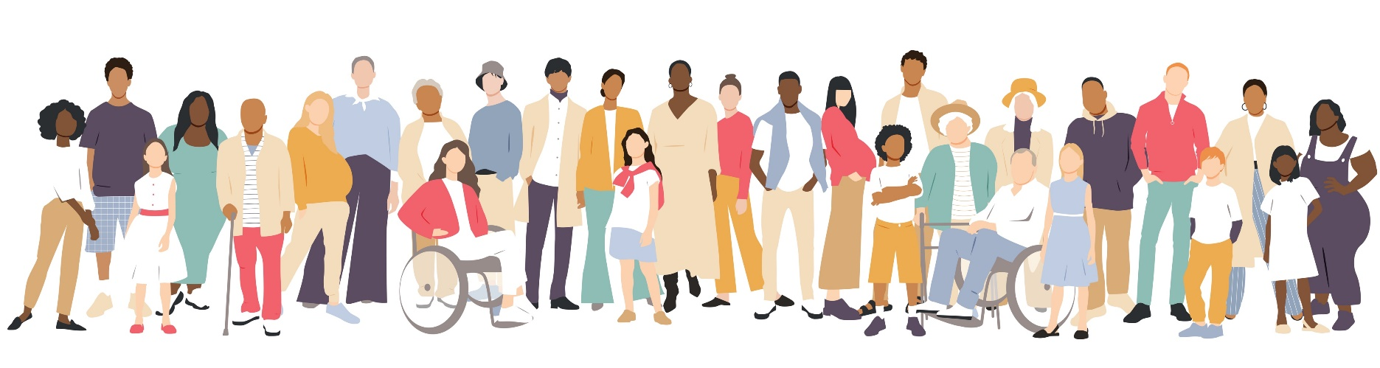
COVID-19 Infection among Racialized Groups
In Canada, there were more COVID-19 infections, COVID-related hospitalizations and deaths among racialized populations compared to non-racialized people.²⁸
Notes:
28. https://www150.statcan.gc.ca/n1/pub/45-280001/2022001/article/00010-eng.htm

Slide 15
COVID-19 Infection among Racialized Groups
For example, despite only representing 9% of Toronto’s population, Black people accounted for nearly 25% of COVID-19 cases in 2020.
In contrast, White people, who represented almost 50% of Toronto’s population, only accounted for close to 22% of cases.²⁹
Notes:
29. https://www.canada.ca/en/public-health/services/reports-publications/health-promotion-chronic-disease-prevention-canada-research-policy-practice/vol-44-no-3-2024/covid-19-black-people-canada-scoping-review.html

Slide 16
Differences in Vaccination Uptake among Racialized Groups
In Ontario, White people were 3x more likely to be vaccinated compared to racialized people.³⁰
This shows a large equity gap in our health and social systems meaning that not everyone has an equal chance of achieving health and well-being.
Notes:
30. https://www.sciencedirect.com/science/article/pii/S0264410X24002044

Slide 17
Differences in Vaccination Uptake by Income Level
In some areas, people with lower income have lower vaccine uptake than those in higher income areas.^{30,31} This may be due to:
Vaccine attitudes
Distrust of the health system
Structural barriers that made it difficult to get the vaccines (e.g., language barriers, lack of accessible vaccine sites)³⁰.
Notes:
30. https://www.sciencedirect.com/science/article/pii/S0264410X24002044
31. https://academic.oup.com/aje/advance-article-pdf/doi/10.1093/aje/kwaf051/62382293/kwaf051.pdf

Slide 18
Differences in Vaccination Uptake by Income Level, (Continued)
In other areas, people in lower income areas have higher rates of vaccination. This may be due to:
Their roles as front-line and service workers who experience increased risk, vaccine mandates, and priority access to COVID-19 vaccines.^{30,32,33}
More research is needed to understand these vaccine disparities and how they impact diverse groups in Ontario.
Notes:
30. https://www.sciencedirect.com/science/article/pii/S0264410X24002044
32. https://pmc.ncbi.nlm.nih.gov/articles/PMC9647403/pdf/10.1177_17151635221123042.pdf
33. https://www.academia.edu/download/90701539/download.pdf

Slide 19
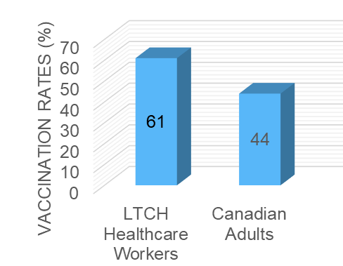
Difference in Vaccination Uptake in
Long-term Care Homes
Influenza vaccination rates among LTCH healthcare workers were higher than those of Ontario adults in the 2023-2024 season, but COVID-19 booster uptake in this group remains low^{23,34*}.
This graph shows Influenza vaccination rates for Ontario LTCH staff versus the general adult population during the
2023-2024 Influenza season:
*Data is not available for RHs as vaccination rates were only mandated for reporting by LTCHs
Notes:
23. https://web.archive.org/web/20250531042823/https://www.canada.ca/en/public-health/services/immunization-vaccines/vaccination-coverage/seasonal-Influenza-survey-results-2023-2024.html
34. https://www.ontarc.com/documents/webinar/20241009MLTCRespiratoryIllnessSeasonPreparedness.pdf

Slide 20
Why might people not be getting vaccinated?

Slide 21

I feel healthy, so I do not need to be vaccinated
I don’t trust the health system
I’m concerned about the safety of the vaccine
Why might people say they do not need to be vaccinated? ^{23,37}
I’m already well protected because of previous vaccine doses I’ve received
I have been infected by COVID-19 before, so I’m protected by natural immunity
Notes:
23. https://web.archive.org/web/20250531042823/https://www.canada.ca/en/public-health/services/immunization-vaccines/vaccination-coverage/seasonal-Influenza-survey-results-2023-2024.html
37. https://rsc-src.ca/en/events/covid-19-policy-briefing/enhancing-covid-19-vaccine-acceptance-in-Canada

Slide 22
You may have heard the term vaccine hesitancy, but what does it mean?
Vaccine hesitancy is “the delay in acceptance or refusal of vaccination despite availability of vaccination services.”³⁸ This term does not provide clear information on the REASONS why people may want or not want to take a vaccine.³⁷
As a vaccine champion, it is important to understand that attitudes are a spectrum of vaccine acceptance.
Notes:
37. https://rsc-src.ca/en/events/covid-19-policy-briefing/enhancing-covid-19-vaccine-acceptance-in-Canada
38. https://pubmed.ncbi.nlm.nih.gov/25896383/

Slide 23
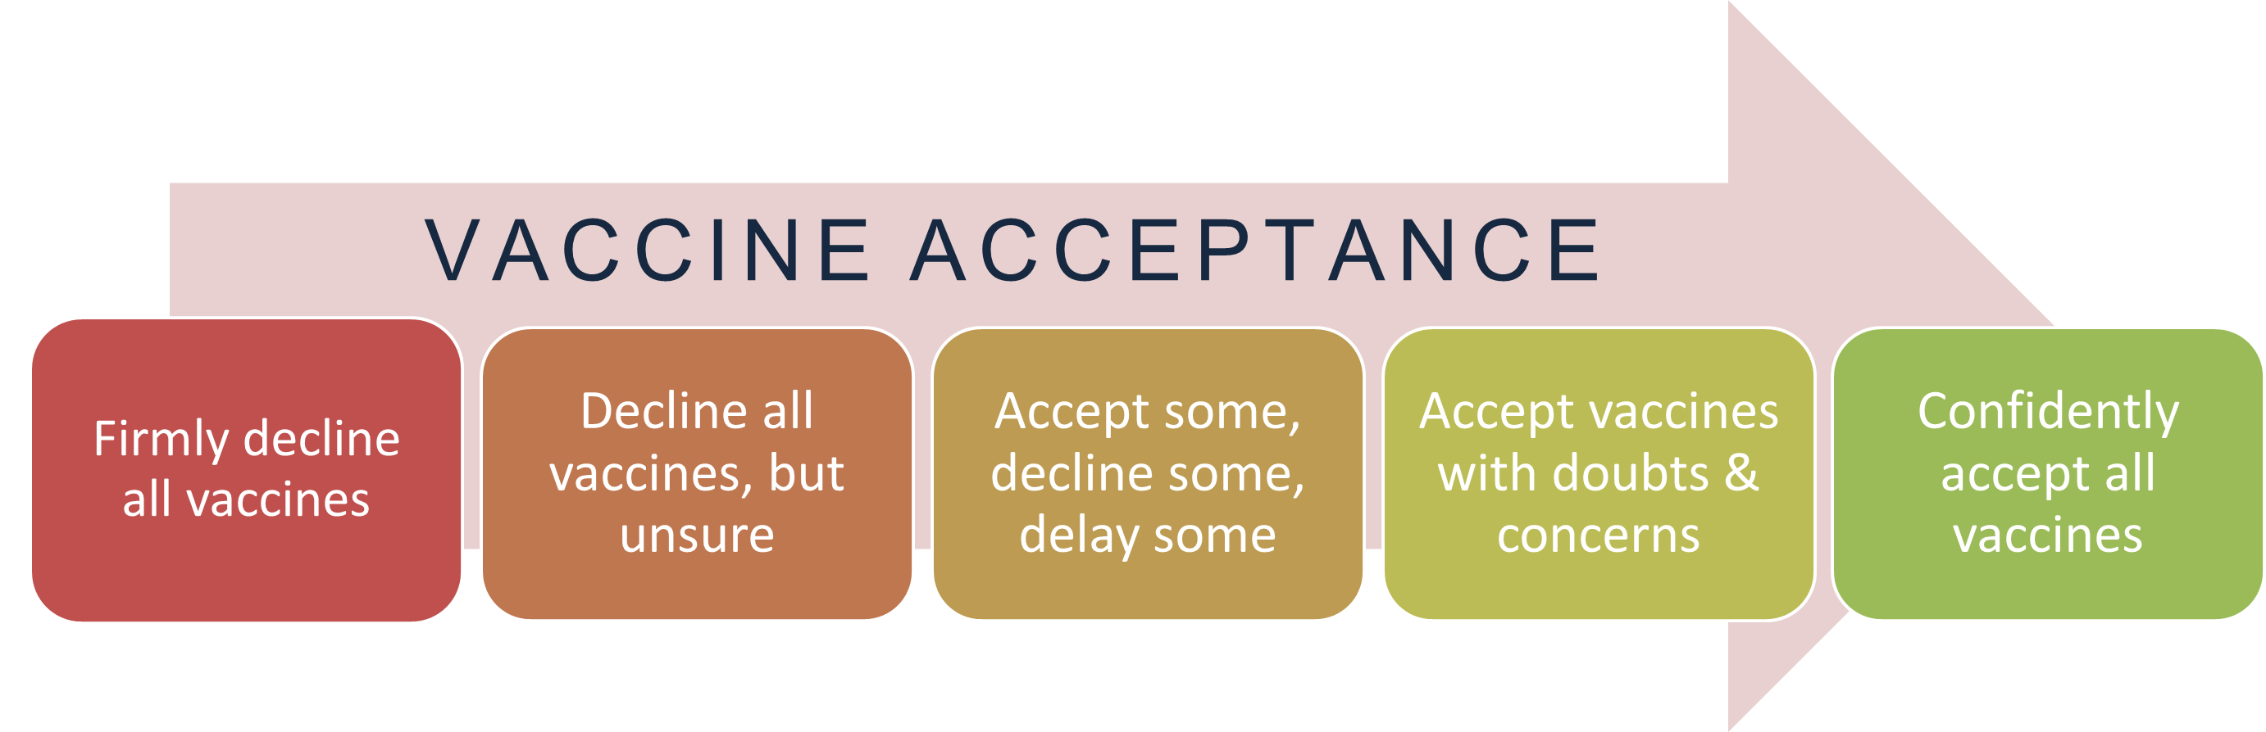
The term vaccine acceptance focuses on attitudes to vaccines (that is, the intention to take a vaccine) instead of the action (that is, following through to take the vaccine).³⁷
There is a range of attitudes to accepting vaccines.
Figure 1: Vaccine acceptance continuum adapted from WHO (2014).
Notes:
37. https://rsc-src.ca/en/events/covid-19-policy-briefing/enhancing-covid-19-vaccine-acceptance-in-canada

Slide 24
Interesting fact:
When a vaccine works really well at preventing the spread and seriousness of a disease, then over time people begin to believe that the disease is less infectious or serious than it truly is, or that a vaccine is unnecessary. This may lead them to delay or decline a vaccine.³⁹
When more and more people delay or decline a vaccine, then the risk of getting the disease begins to rise, and the disease begins to spread faster.³⁹
Notes:
39. https://pmc.ncbi.nlm.nih.gov/articles/PMC9546747/

Slide 25
Because many things influence vaccine acceptance, there are no easy, right, or wrong solutions to promoting it.
What helps one person make a well-informed decision about vaccines might not work for another person.³⁷
Notes:
37. https://rsc-src.ca/en/events/covid-19-policy-briefing/enhancing-covid-19-vaccine-acceptance-in-canada

Slide 26
It is important to correct misinformation and remove disinformation and mal-information*, to ensure people have facts based on good evidence.
Keep in mind that your role as a vaccine champion is just one part of the puzzle! Other important sources of information include public health information, conversations with trusted health workers or trusted community members such as a faith or cultural leader.
*Misinformation: information that is not true³⁷
Disinformation: information that is not true and was deliberately created to mislead or harm others³⁷
Mal-information: information that comes from truth, but is exaggerated or framed in a way that can mislead or harm others⁴⁰
Notes:
37. https://rsc-src.ca/en/events/covid-19-policy-briefing/enhancing-covid-19-vaccine-acceptance-in-canada
40. https://www.cyber.gc.ca/en/guidance/how-identify-misinformation-disinformation-and-malinformation-itsap00300

Slide 27
What were some factors that affected acceptance of the COVID-19 vaccine?
How may they have affected the acceptance of the Influenza vaccine?

Slide 28
Factors affecting COVID-19 vaccine acceptance
Infodemic: too much information – what is correct!?
Knowledge of the disease and the vaccine
Political views
Vaccine fatigue
Accessibility factors
Lived experiences
Fear of vaccines and pain
Also affect the Influenza and other vaccines!
We’ll now explore these in a bit more detail

Slide 29
Infodemic
Infodemic is:
  "the availability of too much information including false or misleading information that can lead to confusion and possibly decisions that do not support positive health behaviours“.⁴¹
The “infodemic” is a concept unique to the COVID-19 pandemic.⁴¹
There was so much information during COVID-19. It was difficult for the public to know what was true and accurate, and what was misinformation, disinformation, or mal-information.
Notes:
41. https://www.who.int/health-topics/infodemic#tab=tab_1

Slide 30
Infodemic (Continued)
The fast spread of this non-factual information spread quickly during COVID-19.^{37,42}
This, and poor communication by government and health authorities led to a loss of public trust.^{37,42}
Notes:
37. https://rsc-src.ca/en/events/covid-19-policy-briefing/enhancing-covid-19-vaccine-acceptance-in-canada
42. https://www.sciencedirect.com/science/article/abs/pii/S0025619620314877

Slide 31
Disease and vaccine knowledge
At the beginning of COVID-19, we didn’t know a lot about the disease or how it spread.
As our understanding improved, so did health guidance. These changes in guidance contributed to the perception of ‘flip flopping’ and further damaged public trust.

Slide 32
Disease and vaccine knowledge
Some people may not think they need the vaccine, and others may not know that you can feel healthy and still spread the virus.⁴³
People also questioned how quickly the vaccine was developed. As we outlined, the vaccines were developed quickly because the scientific community worked together, not because there were shortcuts.
People also had questions about: the safety of mRNA vaccines, side effects, and the effectiveness of the vaccine.^{42,44}
Notes:
42. https://www.sciencedirect.com/science/article/abs/pii/S0025619620314877
43. https://www.canada.ca/en/public-health/services/diseases/respiratory-infectious-diseases-reduce-spread-personal-protective-measures.html
44. https://www.sciencedirect.com/science/article/pii/S0033350621000834

Slide 33
Disease and vaccine knowledge
Some people may not believe that they need to be vaccinated, because they do not see themselves at risk of getting the disease or believing that they would not have a serious or long term infection because they believe they are healthy.^{42,44}
Notes:
42. https://www.sciencedirect.com/science/article/abs/pii/S0025619620314877
44. https://www.sciencedirect.com/science/article/pii/S0033350621000834

Slide 34
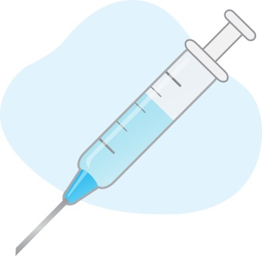
How politics affected views on vaccines
COVID-19 vaccines became a political issue for many people.
Political views impacted people’s views on the motives behind vaccines.^{42,44-48}
Some people did not like the idea of vaccine mandates and viewed this as an infringement on their autonomy,⁴⁴⁻⁴⁸ their ability or right to make decisions for themselves, rather than an action to support or protect themselves and their community.
Notes:
42. https://www.sciencedirect.com/science/article/abs/pii/S0025619620314877
44. https://www.sciencedirect.com/science/article/pii/S0033350621000834
45. https://bmcpublichealth.biomedcentral.com/articles/10.1186/s12889-021-12432-x
46. https://link.springer.com/article/10.17269/s41997-022-00693-x
47. https://publichealth.jmir.org/2021/12/e30424/
48. https://www.jmir.org/2021/4/e26874/

Slide 35
Vaccine Fatigue
Vaccine fatigue is a decreased interest in, willingness or intention to learn more about vaccines or receive a vaccine because of feelings of burden and burnout^{49,50}
Burden and burnout may be a result of stress due to:
  Repeated changes in vaccine guidelines
  Previous mandates for vaccination
  Confusing information about vaccination
  Increased demands for vaccination^{49,50}
Notes:
49. https://pubmed.ncbi.nlm.nih.gov/35359948/
50. https://www.nature.com/articles/s41591-023-02282-y

Slide 36
Barriers to getting vaccinated
Lack of access to transportation, technology (such as phones and computers), or paid time off from work makes it harder for some groups to receive vaccines.^{51,52}
Notes:
51. https://iris.who.int/bitstream/handle/10665/354458/WER9720-eng-fre.pdf?sequence=1
52. https://www.tandfonline.com/doi/full/10.1080/21645515.2022.2129827#abstract

Slide 37
Lived experiences and individual factors
Vaccine acceptance can also be affected by lived experiences, including facing system-wide inequities.^{42,44,53}
Notes:
42. https://www.sciencedirect.com/science/article/abs/pii/S0025619620314877
44. https://www.sciencedirect.com/science/article/pii/S0033350621000834
53. https://doi.org/10.1080/07853890.2024.2445777

Slide 38
Lived experiences and individual factors
People are complex. Our age, gender, income, class, education, and cultural or ethnic background all impact our experiences in the health system, both positive and negative. These factors in turn, can impact vaccine acceptance.⁵⁴⁻⁵⁷
Notes:
54. https://www.who.int/health-topics/health-equity#tab=tab_1
55. https://www.publichealthontario.ca/en/Health-Topics/Health-Equity
56. https://web.archive.org/web/20250419070247/https://vpfo.ubc.ca/2021/03/intersectionality-what-is-it-and-why-it-matters/
57. https://nccdh.ca/images/uploads/comments/NCCDH_Lets-Talk-Intersectionality_EN.pdf

Slide 39
Lived experiences and individual factors
Experiences of colonialism, medical abuse and experimentation, and government neglect in communities can also create mistrust and affect vaccine acceptance and access.⁵²
Many LTCH/RH staff are racialized and/or newcomers and may experience greater barriers to vaccine acceptance.
Notes:
52. https://www.tandfonline.com/doi/full/10.1080/07853890.2024.2445777

Slide 40
Lived experiences and individual factors
For example, a newcomer to Canada, a racialized person, or someone who doesn’t speak English may find accessing vaccines difficult. They may be distrustful of the system, find that care is not culturally relevant, or face discrimination.⁵⁶
This may further disadvantage a person from getting appropriate care such as vaccinations at the appropriate time.
Notes:
56. https://web.archive.org/web/20250419070247/https://vpfo.ubc.ca/2021/03/intersectionality-what-is-it-and-why-it-matters/

Slide 41
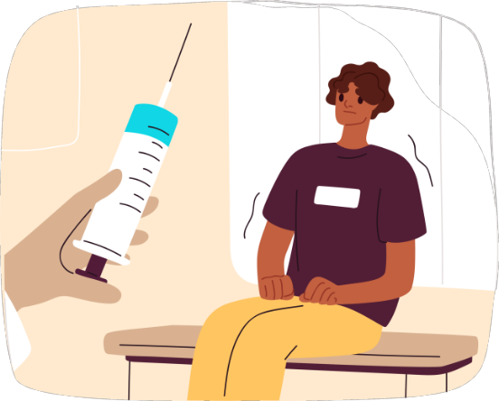
And last but not least …
Fear of vaccines and vaccine pain is a concern that should NOT be overlooked!
In Canada, about 1 in 4 people are afraid of needles,⁵⁸ and 1 in 10 people are concerned about needle pain or fear effects of vaccine decisions.⁵⁹
Notes:
58. https://cpa.ca/psychology-works-fact-sheet-needle-pain/
59. https://rsc-src.ca/en/voices/high-needle-fear-and-covid-19-vaccines

Slide 42
Key takeaways
Despite proven safety and effectiveness of vaccines and widespread availability, vaccine uptake has been falling for both COVID-19 and Influenza vaccines, which leaves us vulnerable to outbreaks.
There are many reasons someone may not be up to date with their vaccines.
  Knowing and understanding why can help you tailor the information to address their concerns with more patience and empathy.

