Slide 1


Module 3: Vaccines and their Importance

Slide 2
Development of Vaccines and Monitoring Vaccine Safety in Canada

Slide 3
Vaccine development and approval
All vaccines go through 3 stages of development:^{1,2}
Exploratory: Scientists look for ways to help the body build protection (immunity) against a disease
Pre-clinical: The vaccine is tested in labs and on animals to make sure it is safe before trying it in humans
Clinical stage: The vaccine is tested in humans to assess safety and effectiveness. Testing is first done in only a small number of people, then eventually it moves to testing thousands of people
Notes:
http://web.archive.org/web/20251119024049/https://www.canada.ca/en/public-health/services/video/covid-19-how-vaccines-developed.html
https://www.canada.ca/en/public-health/services/diseases/2019-novel-coronavirus-infection/prevention-risks/covid-19-vaccine-treatment.html

Slide 4
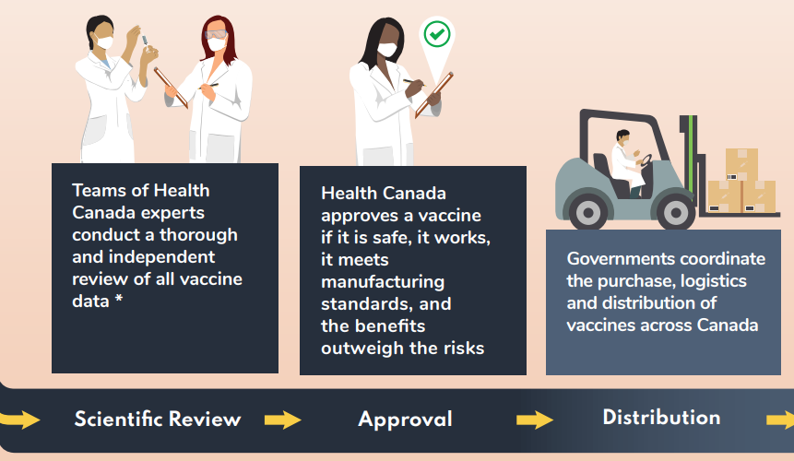
Vaccines in Canada
After the vaccine is developed, Health Canada reviews the scientific and medical evidence to determine if a vaccine is safe and effective.^{1,2}
The COVID-19 and Influenza vaccines have been carefully and thoroughly tested, and meet Health Canada’s safety requirements.
Notes:
http://web.archive.org/web/20251119024049/https://www.canada.ca/en/public-health/services/video/covid-19-how-vaccines-developed.html
https://www.canada.ca/en/public-health/services/diseases/2019-novel-coronavirus-infection/prevention-risks/covid-19-vaccine-treatment.html

Slide 5


Canada’s Vaccine Safety System
Canada uses 8 steps to make sure every vaccine is safe:³
Before the vaccine is approved, experts carefully review and test it in models, in the lab, in animals, and in people to make sure it’s safe and works well
Manufacturers of vaccines must follow strict standards when producing vaccines to make sure they are safe
Notes:
3. http://web.archive.org/web/20250813211921/https://cps.ca/en/documents/position/vaccine-safety-system

Slide 6

Canada’s Vaccine Safety System³
An independent review of the vaccine is done by the National Advisory Committee on Immunization (NACI) to make sure the vaccine is safe and works well
Health care providers have access to a handbook on vaccine delivery that helps them give vaccines safely and correctly
Notes:
3. http://web.archive.org/web/20250813211921/https://cps.ca/en/documents/position/vaccine-safety-system

Slide 7
Canada’s Vaccine Safety System³
There is ongoing monitoring of any adverse events or side effects after vaccination
If an adverse event following immunization occurs, experts will investigate to check if the vaccine caused it
Notes:
3. http://web.archive.org/web/20250813211921/https://cps.ca/en/documents/position/vaccine-safety-system

Slide 8
Canada’s Vaccine Safety System³
Procedures are in place to detect vaccine safety issues, and to immediately recall a vaccine if a safety issue is detected
There are special clinics with specialized, trained staff who can help people who have had side effects after vaccination
Notes:
3. http://web.archive.org/web/20250813211921/https://cps.ca/en/documents/position/vaccine-safety-system

Slide 9
COVID-19 Vaccine Safety

Slide 10
What is COVID-19?
COVID-19 is a respiratory illness (an illness that affects the lungs and airways)⁴
It can be very contagious, and spreads through the droplets released when infected people breathe, cough, sneeze, or talk^{5,6}
Symptoms range from mild to severe. Examples include:⁶
  Coughing
  Sore throat
  Congestion
  Vomiting
  New loss of taste or smell
More severe outcomes and complications from infection can include respiratory failure, kidney failure, or lasting heart muscle damage⁶
Notes:
4. https://www.canada.ca/en/public-health/services/diseases/2019-novel-coronavirus-infection/health-professionals.html
5. https://www.health.harvard.edu/diseases-and-conditions/coronavirus-resource-center
6. https://www.hopkinsmedicine.org/health/conditions-and-diseases/coronavirus

Slide 11
COVID-19 Vaccine Safety – Common Questions
Are COVID-19 vaccines safe?
Yes, the vaccines are safe. They have been tested rigorously and meet Health Canada’s safety requirements.^{7,8}
Notes:
7. https://www.canada.ca/en/public-health/services/diseases/coronavirus-disease-covid-19/vaccines/safety-side-effects.html
8. https://www.hopkinsmedicine.org/health/conditions-and-diseases/coronavirus/covid-19-vaccine-what-you-need-to-know

Slide 12

COVID-19 Vaccine Safety – Common Questions
Were the COVID-19 vaccines rushed out?
No, the vaccines were not rushed out. They were created quickly and successfully because:
Scientists used decades of research done before the COVID-19 pandemic to help create the vaccines
There were world-wide, coordinated efforts in the development⁹
  Imagine a group of chefs preparing a meal together; they would create it much more quickly than if they were working alone
Image by Freepik
Notes:
9. https://cihr-irsc.gc.ca/e/52424.html

Slide 13
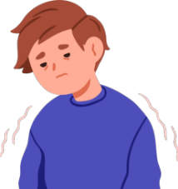
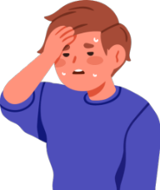

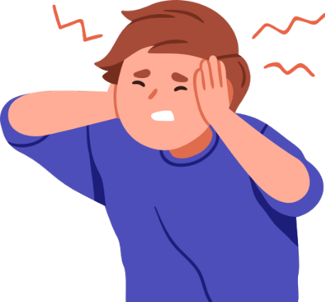

COVID-19 Vaccine Safety – Common Questions
Does getting vaccinated lead to adverse reactions (side effects)?¹⁰
Most side effects after vaccination are mild and only last a few days (e.g., you may experience headaches, fatigue, your arm being sore and/or red)⁷
Serious side effects are rare. All serious side effects are reviewed to determine any additional safety steps to be taken.
Notes:
7. https://www.canada.ca/en/public-health/services/diseases/coronavirus-disease-covid-19/vaccines/safety-side-effects.html
10. https://www.canada.ca/en/health-canada/services/drugs-health-products/medeffect-canada/adverse-reaction-reporting/adverse-reactions-side-effects.html

Slide 14
COVID-19 Vaccine Safety – Common Questions
What are some potential side effects?
Severe allergic reactions, which may involve signs such as difficulty breathing, rapid heartbeat, or widespread skin rash or swelling⁷ are seen in only about 1 per 100,000 vaccinations in Canada¹²
Myocarditis (inflammation of the heart muscle) or pericarditis (inflammation of the lining around the heart), which are rare
  People are more likely to experience myocarditis or pericarditis due to a COVID-19 infection than due to the vaccine¹⁴⁻¹⁶
  Most people can receive medicine and recover quickly from these conditions^{7,12}
Notes:
7. https://www.canada.ca/en/public-health/services/diseases/coronavirus-disease-covid-19/vaccines/safety-side-effects.html
12. https://health-infobase.canada.ca/covid-19/vaccine-safety/summary.html
14. https://pmc.ncbi.nlm.nih.gov/articles/PMC9467278/
15. https://www.nature.com/articles/s41541-024-00893-1#Sec15
16. https://www.sciencedirect.com/science/article/pii/S0753332224000623

Slide 15
COVID-19 Vaccine Safety – Common Questions
What are some potential side effects? (Continued)
Experiences of facial muscle weakness or paralysis (Bell’s Palsy) are rare, and are generally temporary and start to improve after a few weeks⁷
After vaccination, it is important to wait and be monitored for the recommended amount of time to watch for possible side effects. If you experience any side effects after leaving, report it to your healthcare provider.
Notes:
7. https://www.canada.ca/en/public-health/services/diseases/coronavirus-disease-covid-19/vaccines/safety-side-effects.html

Slide 16
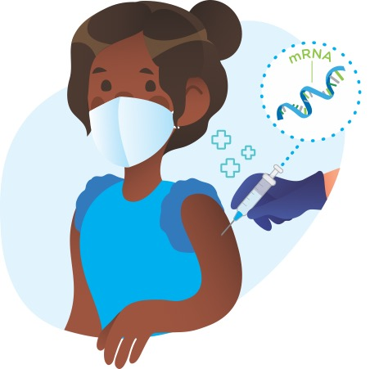
How do COVID-19 vaccines work?
Step 1. The vaccines protect you by teaching your immune system how to produce antibodies to a small section of the COVID-19 virus—without the harmful effects of getting sick from the virus.
Getting sick from the virus also produces antibodies. However, vaccination causes a more predictable immune response to the virus that causes COVID-19.^{8,17}
Notes:
8. https://www.hopkinsmedicine.org/health/conditions-and-diseases/coronavirus/covid-19-vaccine-what-you-need-to-know
17. https://www.bccdc.ca/Health-Info-Site/Documents/COVID-19_vaccine/Vaccination_After_COVID19.pdf

Slide 17
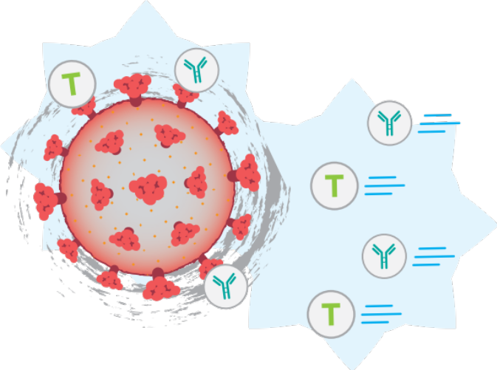
How do COVID-19 vaccines work?
Step 2. If you are exposed to the COVID-19 virus, your body recognizes the protein on the virus, remembers the immune response, and begins to make the antibodies that will attack the virus and protect you from serious disease.¹⁸⁻²⁰
Notes:
18. https://www.toronto.ca/community-people/health-wellness-care/health-programs-advice/respiratory-viruses/covid-19/covid-19-vaccines/
19. http://web.archive.org/web/20251009120745/http://www.bccdc.ca/health-info/diseases-conditions/covid-19/covid-19-vaccine/vaccines-for-covid-19
20. https://www.canada.ca/en/health-canada/services/drugs-health-products/covid19-industry/drugs-vaccines-treatments/vaccines.html

Slide 18
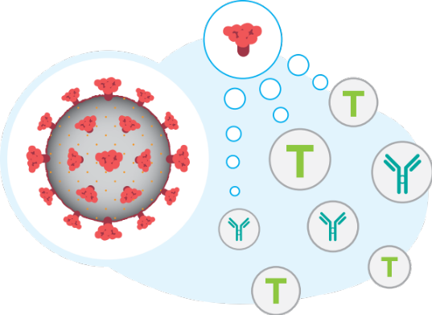
Which COVID-19 vaccines are approved in Canada?
mRNA vaccines¹⁸⁻²⁰
Includes Pfizer-BioNTech Comirnaty (also known as just Pfizer) and Moderna Spikevax (also known as just Moderna)²¹
These vaccines carry instructions (mRNA) from the COVID-19 virus to make harmless proteins or virus pieces that don’t cause disease, but trigger your immune system to make antibodies
After the proteins/virus pieces are made, your body will then remove the instructions (mRNA) from your body
These do not alter your DNA in any way
Notes:
18. https://www.toronto.ca/community-people/health-wellness-care/health-programs-advice/respiratory-viruses/covid-19/covid-19-vaccines/
19. http://web.archive.org/web/20251009120745/http://www.bccdc.ca/health-info/diseases-conditions/covid-19/covid-19-vaccine/vaccines-for-covid-19
20. https://www.canada.ca/en/health-canada/services/drugs-health-products/covid19-industry/drugs-vaccines-treatments/vaccines.html
21. https://www.canada.ca/en/public-health/services/publications/healthy-living/canadian-immunization-guide-part-4-active-vaccines/page-26-covid-19-vaccine.html

Slide 19
Which COVID-19 vaccines are approved in Canada?
Protein subunit vaccines¹⁸⁻²⁰
Includes Novavax Nuvaxoivid (also known as just Novavax)
This vaccine carries harmless proteins or virus pieces that don’t cause disease from the COVID-19 virus, but like the mRNA vaccines they trigger your immune system to make antibodies
Due to low demand, this type of vaccine is not available in Canada²¹
Notes:
19. http://web.archive.org/web/20251009120745/http://www.bccdc.ca/health-info/diseases-conditions/covid-19/covid-19-vaccine/vaccines-for-covid-19
20. https://www.canada.ca/en/health-canada/services/drugs-health-products/covid19-industry/drugs-vaccines-treatments/vaccines.html
21. https://www.canada.ca/en/public-health/services/publications/healthy-living/canadian-immunization-guide-part-4-active-vaccines/page-26-covid-19-vaccine.html

Slide 20
COVID-19 Vaccines in Canada – Common Questions
Is the AstraZeneca vaccine still available in Canada?
No, the AstraZeneca vaccine is no longer available in Canada²²
Of the different vaccines in Canada, is one better than the other?
Both the mRNA and protein subunit vaccines are effective²¹
Both of the mRNA vaccines (Pfizer and Moderna) are also similarly effective to one another²¹
As such, it is recommended that you receive whichever vaccine is currently available
Notes:
21. https://www.canada.ca/en/public-health/services/publications/healthy-living/canadian-immunization-guide-part-4-active-vaccines/page-26-covid-19-vaccine.html
22. https://www.canada.ca/en/health-canada/services/drugs-health-products/covid19-industry/drugs-vaccines-treatments/vaccines/astrazeneca.html

Slide 21
Influenza Vaccine Safety

Slide 22
What is Influenza (also known as the flu)?
Influenza is a respiratory illness caused by viruses that infect the nose, throat, and sometimes the lungs^{24,25,78}
It is contagious, and spreads mainly from the droplets released when infected people breathe, cough, sneeze, or talk²⁴
Symptoms range from mild to severe. Examples include:²⁵
  Fever
  Headache
  Cough
  Sore throat
  General aches/pains
More severe outcomes and complications from infection can include ear infections, pneumonia, sinus infections, and heart complications⁷⁹
Notes:
24. https://www.publichealthontario.ca/en/Diseases-and-Conditions/Infectious-Diseases/Respiratory-Diseases/Influenza
25. https://www.canada.ca/en/public-health/services/diseases/flu-influenza.html
78. https://www.canada.ca/en/public-health/services/diseases/flu-influenza/prevention-risks.html
79. https://www.toronto.ca/community-people/health-wellness-care/health-programs-advice/immunization/influenza-flu/

Slide 23


Influenza Vaccine Safety – Common questions
Are Influenza vaccines safe?
Yes, the vaccines are safe. They have been tested rigorously and meet Health Canada’s safety requirements.^{26,27}
Notes:
26. https://www.healthlinkbc.ca/healthlinkbc-files/influenza-flu-immunization-myths-and-facts
27. https://www.canada.ca/en/public-health/services/publications/vaccines-immunization/national-advisory-committee-immunization-summary-statement-seasonal-influenza-vaccines-2026-2027.html

Slide 24
Influenza Vaccine Safety – Common questions
Does getting vaccinated lead to adverse reactions (side effects)?
Severe adverse reactions or side effects are rare. Most side effects after vaccination are mild and only last a few days (e.g., you may experience headaches, fatigue, your arm being sore and/or red).^{26,28}
Notes:
26. https://www.healthlinkbc.ca/healthlinkbc-files/influenza-flu-immunization-myths-and-facts
28. https://www.canada.ca/en/public-health/services/diseases/flu-influenza/get-your-flu-shot.html

Slide 25
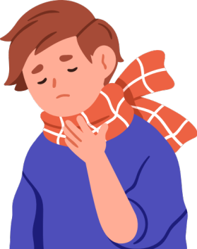
Influenza Vaccine Safety – Common questions
What are some potential side effects?
Serious allergic reactions, which may involve signs such as difficulty breathing, rapid heartbeat, or an itchy rash, can occur in rare cases^{29,30}
Oculo-respiratory syndrome (ORS), is another side effect which can lead to red eyes and a cough or sore throat. ORS has become less frequent through the years. Some data suggest that ORS occurs in 19 cases per 1 million Influenza vaccines given^{31,32}
Notes:
29. https://www.toronto.ca/community-people/health-wellness-care/health-programs-advice/immunization/flu-influenza-vaccines/
30. https://www.canada.ca/en/public-health/services/vaccination-children/safety-concerns-side-effects.html
31. https://www.canada.ca/en/public-health/services/reports-publications/canada-communicable-disease-report-ccdr/monthly-issue/2005-31/oculo-respiratory-syndrome-following-influenza-vaccination-review-post-marketing-surveillance-through-four-influenza-seasons-canada.html
32. https://www.canada.ca/en/public-health/services/publications/healthy-living/canadian-immunization-guide-part-4-active-vaccines/page-10-influenza-vaccine.html

Slide 26
Influenza Vaccine Safety – Common questions
What are some potential side effects? (Continued)
Guillain-Barré syndrome, which can cause muscle weakness and paralysis, only occurs in about 1-2 cases per 1 million Influenza vaccines given
  People are more likely to get this syndrome from influenza itself than from the vaccine³³
After vaccination, it is important to wait and be monitored for the recommended amount of time to watch for possible side effects. If you experience any side effects after leaving, report it to your healthcare provider.
Notes:
33. https://www.thelancet.com/journals/laninf/article/PIIS1473-3099(13)70104-X/abstract

Slide 27
How do Influenza vaccines work?
Step 1. The Influenza vaccine contains an inactivated Influenza virus, or proteins from the virus. This exposure teaches your immune system to produce antibodies in response to Influenza.
Step 2. If you are exposed to Influenza, your body recognizes the protein on the virus, and produces antibodies that attack the virus and provide protection against illness.³⁴⁻³⁶
Notes:
34. https://www.princeedwardisland.ca/sites/default/files/publications/hd_influenza_inactivated_fact_sheet_2023_final.pdf
35. https://www.fda.gov/consumers/consumer-updates/fdas-critical-role-ensuring-safe-and-effective-flu-vaccines
36. http://web.archive.org/web/20250723123105/https://www.cedars-sinai.org/newsroom/how-does-the-flu-vaccine-work/

Slide 28
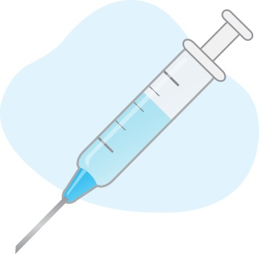
What types of Influenza vaccines are available?
All publicly funded Influenza vaccines in Ontario are made using inactivated Influenza viruses. This vaccine is given as an injection in your shoulder.³⁷
Different Influenza vaccines are available each year to target the Influenza viruses that are expected to spread that year.²⁶
Certain populations, such as older adults and those with weaker immune systems are eligible to receive enhanced vaccines, which contain either larger amounts of an ingredient, or an extra ingredient, which help to build a stronger immune response.³⁸
Notes:
26. http://web.archive.org/web/20240720005124/https://immunizebc.ca/vaccines/influenza
37. https://www.ontario.ca/files/2024-09/moh-uiip-24-25-6mo-64-fact-sheet-en-2024-09-25.pdf
38. http://web.archive.org/web/20241208112615/https://www.publichealthontario.ca/-/media/Documents/V/2023/vaccines-influenza-season.pdf

Slide 29
Importance of the Vaccines

Slide 30
Why is it important to keep up with getting the COVID-19 and Influenza vaccines?
Protection from getting the vaccines, as well as immunity after infection, goes away over time^{32,39}
Unlike routine vaccines (e.g., tetanus, polio), whose immunity can last longer,^{40,41}
  Influenza vaccine: Usually provides protection for around 6 months^{42,43}
  COVID-19 vaccine: Protection is strongest the first 3 months after vaccination. It continues providing protection against severe illness for around 6 months^{8,23}
Notes:
8. https://www.hopkinsmedicine.org/health/conditions-and-diseases/coronavirus/covid-19-vaccine-what-you-need-to-know
23. https://publichealth.jhu.edu/2024/what-to-know-about-updated-covid-vaccines-for-2024-25
32. https://www.canada.ca/en/public-health/services/publications/healthy-living/canadian-immunization-guide-part-4-active-vaccines/page-10-Influenza-vaccine.html
39. https://www.canada.ca/en/public-health/services/diseases/2019-novel-coronavirus-infection/awareness-resources/know-vaccine.html
40. https://www.healthlinkbc.ca/health-library/immunizations/schedules/children#:~:text=Children%20are%20offered%20routine%20vaccines,Rotavirus%20vaccine.
41. https://www.canada.ca/en/public-health/services/publications/healthy-living/canadian-immunization-guide-part-1-key-immunization-information/page-13-recommended-immunization-schedules.html
42. https://www.quebec.ca/en/health/advice-and-prevention/vaccination/flu-vaccine
43. http://web.archive.org/web/20250726071628/https://www.uchicagomedicine.org/forefront/prevention-and-screening-articles/frequently-asked-questions-about-the-flu-vaccine

Slide 31
Why is it important to keep up with getting the COVID-19 and Influenza vaccines?
The COVID-19 and Influenza viruses are constantly evolving, meaning:
Continuing to get vaccinated protects you from the current COVID-19 variants⁸, and from the Influenza viruses that are expected to spread each year³²
Notes:
8. https://www.hopkinsmedicine.org/health/conditions-and-diseases/coronavirus/covid-19-vaccine-what-you-need-to-know
32. https://www.canada.ca/en/public-health/services/publications/healthy-living/canadian-immunization-guide-part-4-active-vaccines/page-10-Influenza-vaccine.html

Slide 32
Why is it important to keep up with getting the COVID-19 and Influenza vaccines if I can still get infected?
The vaccines will not always prevent infection, but they are extremely effective at reducing serious illness, including:
Serious infection, hospitalization, or death³²
  In 2023/24, people who got the COVID-19 vaccine were half as likely to need medical care for an infection⁴⁵
  The 2024/25 Influenza vaccine cut the risk of getting a serious respiratory illness that required medical attention⁴⁶
The COVID-19 vaccine reduces the risk of post COVID-19 condition (long COVID) symptoms⁴⁷
Notes:
32. https://www.canada.ca/en/public-health/services/publications/healthy-living/canadian-immunization-guide-part-4-active-vaccines/page-10-Influenza-vaccine.html
45. https://www.eurosurveillance.org/content/10.2807/1560-7917.ES.2024.29.7.2400076
46. https://www.eurosurveillance.org/content/10.2807/1560-7917.ES.2025.30.4.2500059
47. https://www.canada.ca/en/public-health/services/diseases/2019-novel-coronavirus-infection/symptoms/post-covid-19-condition/prevention-risks.html

Slide 33
What is another important reason for keeping up with getting the Influenza vaccine each flu season?
The Influenza vaccine may help prevent the worsening of certain chronic health conditions.
People with chronic health conditions are at higher risk of Influenza complications (e.g., pneumonia)⁴⁸
Vaccination can make people less likely to experience flu-related worsening of chronic lung disease⁴⁹
Vaccination may help lower rates of cardiac events for those with heart disease^{49,50}
Notes:
48. https://www.mayoclinic.org/diseases-conditions/heart-disease/in-depth/flu-shots/art-20044238
49. https://pubmed.ncbi.nlm.nih.gov/24150467/
50. https://www.nature.com/articles/s41598-023-47690-9

Slide 34
Vaccines in Long-Term Care Homes (LTCH) and Retirement Homes (RH)

Slide 35
Vaccination Uptake in Canadian LTCH/RHs
During COVID-19, LTCH and RH staff were required to receive COVID-19 vaccines⁵¹. This mandate was later revoked in March 2022⁵²
Approximately 99.79% of LTCH/RH staff in Ontario received the first two doses of the COVID-19 vaccine by December 2021⁵³
Since then, uptake of COVID-19 boosters and Influenza vaccines have dropped⁵⁴
  Possible reasons for this include vaccine fatigue⁵⁵ or feeling protected by previous vaccines.⁵⁶ More reasons why people may not get vaccinated will be covered in the next module.
Notes:
51. https://news.ontario.ca/en/release/1000917/ontario-taking-additional-steps-to-protect-long-term-care-home-residents
52. https://www.ontario.ca/page/ministers-directive-long-term-care-home-covid-19-immunization-policy
53. https://data.ontario.ca/dataset/long-term-care-home-covid-19-data
54. https://www.publichealthontario.ca/-/media/Documents/S/24/staff-Influenza-immunization-coverage-hospital-ltc.pdf?rev=35122f95ad714f83af1ed2751d973ff0&sc_lang=en
55. https://health-infobase.canada.ca/vaccination-coverage/key-populations/plans.html
56. https://www.canada.ca/content/dam/phac-aspc/documents/services/immunization-vaccines/vaccination-coverage/seasonal-influenza-survey-results-2023-2024/full-report/full-report.pdf

Slide 36

Is there an effect on resident mortality when healthcare workers receive the Influenza vaccine?
Let’s look at some evidence.
We’ll begin with some information on randomized control trials (RCTs)⁷⁷.
Notes:
77. https://cihr-irsc.gc.ca/e/49806.html#a4

Slide 37
What is a randomized control trial (RCT)?
A type of experiment where individuals or groups of individuals are randomly (that is, by chance) assigned to receive a treatment such as a medicine or information
The group that receives the treatment or intervention is called the treatment group
The group that does not receive the treatment or intervention is called the control group

Slide 38
What is a randomized control trial (RCT)?
(continued)
At the end of the experiment, the results or outcomes for each group are compared.
For example, are there differences in the number of symptoms between the group that took the medicine (treatment group) and the one that did not (control group); or was there a difference in behaviour between the group that received information (treatment group) and the one that did not (control group)?

Slide 39
What is a randomized control trial (RCT)?
(continued)
A statistically significant difference between group outcomes means that there is strong support or reliable evidence that the difference in outcomes did not occur by chance—there’s a real difference.
For example, the group that took the medicine had significantly lower number of symptoms than the group that did not, or; the group that received the information was significantly more likely to complete an action—a behaviour—than the group that did not receive the information.

Slide 40
RCTs: Influenza vaccination in healthcare workers
Outcome of interest: Resident mortality
Randomized Control Trial (RCT) | Control outcome [% deaths] | Treatment outcome [% deaths] | Significant Difference?
1,059 residents in 12 LTCHs, Scotland⁷³ | 17% | 12% | Yes
1,437 patients in 20 elder-care hospitals, UK⁷⁴ | 22% | 14% | Yes
2,604 residents in 44 LTCHs, UK⁷⁵ | 15% | 11% | Yes
3,483 residents in 40 LTCHs, France⁷⁶ | 6% | 5.2% | Yes
Notes:
73. https://academic.oup.com/jid/article/175/1/1/825903?login=true
74. https://www.thelancet.com/journals/lancet/article/PIIS0140-6736(99)05190-9/fulltext
75. https://www.bmj.com/content/333/7581/1241
76. https://pubmed.ncbi.nlm.nih.gov/19682118/

Slide 41
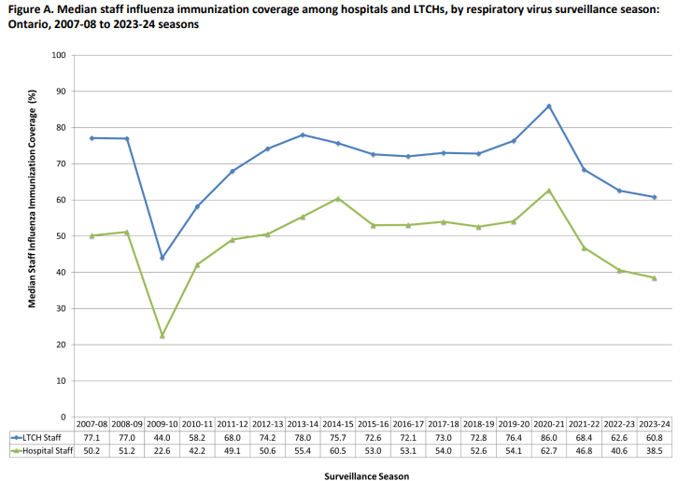
What are recent Influenza vaccination uptake trends in LTCHs?
The blue line in this graph shows the percentage of Ontario LTCH staff that received an Influenza vaccine, by flu season.
Influenza vaccination coverage has notably decreased between 2020-21 (86% uptake) and 2023-24 (61% uptake).⁵⁴
Notes:
54. https://www.publichealthontario.ca/-/media/Documents/S/24/staff-Influenza-immunization-coverage-hospital-ltc.pdf?rev=35122f95ad714f83af1ed2751d973ff0&sc_lang=en

Slide 42
What are recent COVID-19 vaccination uptake trends in LTCHs/RHs?
Data on recent COVID-19 vaccine uptake among staff in Canada is not available in summary form as of 2025.
However, beginning in May 2021, our team led a study called Wellness Hub, where we collected vaccine data from 72 LTCH and RHs. The results from this study will be covered in the next slide.

Slide 43
What are recent COVID-19 vaccination uptake trends in LTCHs/RHs?
We found that:⁵⁷
Prior to March 2022, when mandatory vaccination was in place:
  97% of staff had taken the COVID-19 vaccine
  52% of staff received a COVID-19 booster
After March 2022, when mandatory vaccination was lifted, only 10% of staff received a second booster
We anticipate that recent uptake of COVID-19 boosters in LTCH/RH staff population remains quite low
Notes:
57. Wellness Hub, unpublished data. OSF protocol: https://osf.io/pmur4/?view_only=

Slide 44
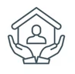
Outbreaks in Canada: LTCHs and RHs
Between August 2023 - March 2024:⁵⁸⁻⁶⁰
Of the 615 LTCHs in Ontario
Of the ~780 RHs in Ontario
There were over 1,200 COVID-19 and 190 Influenza outbreaks
There were over 950 COVID-19 and 70 Influenza outbreaks
Respiratory infection outbreaks continue to impact LTCHs/RHs, as they can lead to negative health outcomes and death for vulnerable residents, as well as impact staff’s health, work, and take-home pay.
Notes:
58. https://www.oltca.com/about-long-term-care/the-data/
59. https://www.publichealthontario.ca/-/media/Documents/nCoV/ltcrh/23/covid-19-influenza-rsv-outbreaks-ltcrhs.pdf
60. https://www.ontario.ca/page/find-retirement-home#:~:text=Ontario%20is%20home%20to%20nearly%20780%20licensed%20retirement%20homes.

Slide 45
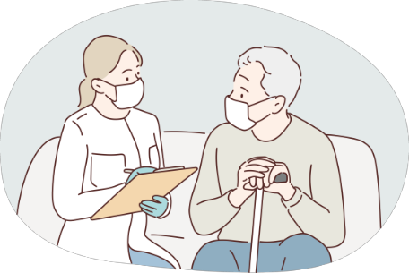
Infection Risks in LTCHs and RHs
Long-term Care Home residents and staff are more at-risk of infections due to:
  Unavoidable close contact between staff and residents⁶¹
  The possibility of staff working at multiple care homes, increasing transmission risk⁶¹
  Residents being vulnerable, as they are often older, frailer, and more likely to have chronic conditions and suffer from cognitive decline or dementia⁶¹
  Staff often living in neighbourhoods where other essential/frontline workers live, and where there may be higher rates of COVID-19⁶²
Notes:
61. https://science.gc.ca/site/science/en/office-chief-science-advisor/initiatives-covid-19/long-term-care-and-covid-19
62. https://publichealth.jmir.org/2022/10/e34927

Slide 46
Why is it important for LTCH/RH staff to be vaccinated?
Protecting their own health, and those close to them
Staying up-to-date on the COVID-19 and Influenza vaccines helps to protect oneself, family, and friends from serious illness, hospitalization, or death⁶³
Notes:
63. https://www.publichealthontario.ca/-/media/documents/ncov/ltcrh/2020/06/covid-19-prevention-management-ltcrh.pdf

Slide 47
Why is it important for LTCH/RH staff to be vaccinated?
Preventing outbreaks in homes
Vaccination is a collective action to prevent the spread of infection. Having high vaccination rates (plus other outbreak preparedness measures like infection prevention and control) among staff and residents can help prevent and limit the spread of infection in LTCH/RHs⁵²
Notes:
52. https://www.ontario.ca/page/ministers-directive-long-term-care-home-covid-19-immunization-policy

Slide 48
Why is it important for LTCH/RH staff to be vaccinated?
Preventing outbreaks in homes, continued
Even if you have no symptoms, you can still infect others in your home^{64,65}
Studies show that staff vaccination helps protect LTCHs from COVID-19 infection and Influenza-like illness outbreaks⁶⁶⁻⁷¹
Notes:
64. https://www.canada.ca/en/public-health/services/diseases/2019-novel-coronavirus-infection/symptoms.html
65. https://www.canada.ca/en/public-health/services/diseases/flu-influenza/prevention-risks.html
66. https://pmc.ncbi.nlm.nih.gov/articles/PMC3414018/#R-2-35
67. https://www.sciencedirect.com/science/article/abs/pii/S1525861006003331
68. https://www.cambridge.org/core/journals/infection-control-and-hospital-epidemiology/article/abs/influenza-vaccination-levels-and-influenzalike-illness-in-longtermcare-facilities-for-elderly-people-in-niigata-japan-during-an-influenza-a-h3n2-epidemic/02C1BC48438C959F0816AD6BC246778E
69. https://www.cmaj.ca/content/164/10/1413.short
70. https://pmc.ncbi.nlm.nih.gov/articles/PMC8053216/
71. https://pmc.ncbi.nlm.nih.gov/articles/PMC8603404/

Slide 49
Why is it important for LTCH/RH staff to be vaccinated?
Protecting at-risk residents
Older adults, especially those with health conditions, are more likely to get very ill from COVID-19, making protecting one’s LTCH/RH from outbreaks very important⁶¹
A research study from 2021 suggests that if all homes had high staff vaccination rates, 29% of COVID-19 cases and 48% of COVID-19-related deaths among residents may have been prevented⁷²
Notes:
61. https://science.gc.ca/site/science/en/office-chief-science-advisor/initiatives-covid-19/long-term-care-and-covid-19
72. https://www.nejm.org/doi/pdf/10.1056/NEJMc2115674

Slide 50
Why is it important for LTCH/RH staff to be vaccinated?
Prevents disruption to work
As vaccines can help protect you from illness, this allows you to continue working and supporting residents during an outbreak, reducing the need to take time off, and therefore preventing reduction in take home pay

Slide 51
Key Takeaways
The COVID-19 and Influenza vaccines are safe, and go through a rigorous development and approval process to ensure their safety
The COVID-19 and Influenza vaccines protect you by teaching your body to recognize and attack viruses
Continuing to get vaccinated is important, as it can provide benefits such as preventing serious illness and reducing one’s risk of getting or spreading infection
Continuing to get vaccinated in LTCH/RHs is especially important in protecting the health of both staff and vulnerable residents. Despite this, vaccine uptake among staff has been dropping

