Slide 1


Module 2:
Outbreak Preparedness

Slide 2

3 Components of Outbreak Preparedness¹
Well-being
Vaccines
Other infection prevention and control (IPAC) procedures
Notes:
1. https://www.medrxiv.org/content/10.1101/2024.06.19.24308949v1.full
VOICEOVER:
During the COVID-19 pandemic, we looked at pandemic-related challenges in LTCHs and RHs, and found that challenges could be mostly summarized to fit within these 3 buckets or components. Consideration of these 3 components may be a helpful starting point for preparing for other infectious disease outbreaks.
It is also true that Vaccines are often thought of as Infection prevention and control measures, however, we found that the challenges around mis- and disinformation about vaccines, and getting vaccines was important enough to need special mention, and dedicated efforts to address the challenges.

Slide 3
3 Components of Outbreak Preparedness
Vaccines are one of the important ways for preventing outbreaks
Well-being, infection prevention and control (IPAC) measures, and vaccines all have specific roles in outbreak preparedness – and they influence one another!
  For example, burnout can affect your ability to practice and maintain IPAC measures or vaccine uptake¹
The best way to prevent and prepare for outbreaks is to have all three components available and working together
Notes:
1. https://www.medrxiv.org/content/10.1101/2024.06.19.24308949v1.full

Slide 4
Well-being
Staff well-being, including level of burnout, morale, and physical and mental health may be vital to consider and improve in outbreak prevention¹
Low well-being can worsen issues such as low commitment to infection prevention and control, and vaccine fatigue¹
Staff may consider forming or joining a wellness committee within their LTCH/RH to support wellness efforts¹
Notes:
1. https://www.medrxiv.org/content/10.1101/2024.06.19.24308949v1.full
VOICEOVER
The work we did during the COVID-19 pandemic found that well-being may be important to consider when addressing or trying to prevent outbreaks in LTCH/RHs.

Slide 5
Well-being resources
For more information about well-being, you can visit:
  Wellness Hub's main webpage² for lots of different resources and topics
  The Wellness Hub's CARE+ workbook³ for a PDF mental wellness workbook with different evidence-based strategies and exercises
  The Wellness Hub's guide for planning a Wellness Day in congregate settings⁴ if you want to organize a Wellness Day at your workplace
  The Wellness Hub's Peer-to-Peer Support toolkit⁵ for guidance on supporting your peers and colleagues with their well-being
Notes:
2. Wellness Hub’s main webpage: https://wellness-hub.ca/
3. CARE+ workbook: https://wellness-hub.ca/wp-content/uploads/WellnessHub_Care_Booklet_Feb2024_v3-compressed.pdf
4. Wellness Day guide: https://wellness-hub.ca/wp-content/uploads/Wellness_Day_Planning_Guide_August_2022_v3.pdf
5. Peer-to-Peer Support toolkit: https://wellness-hub.ca/wp-content/uploads/Wellness-Day_-Peer-Support_-Toolkit_Benefits-of-Peer-support-research_IG_OCT2022_v3.pdf

Slide 6
Infection Prevention and Control (IPAC) Practices
Examples of IPAC practices include:^{6,7}
Hand hygiene
(e.g., properly washing your hands, washing your hands prior to putting on a mask)
Respiratory hygiene
(e.g., coughing into a tissue or your elbow)
HVAC:
Proper ventilation, heating, and air conditioning systems
Notes:
6. https://www.canada.ca/en/public-health/services/diseases/2019-novel-coronavirus-infection/prevent-control-covid-19-long-term-care-homes.html
7. http://web.archive.org/web/20260218183306/https://www.publichealthontario.ca/-/media/documents/I/2021/ipac-ltch-principles-best-practices

Slide 7
IPAC Practices, continued
Other examples of IPAC practices also include:^{6,7}
Environmental cleaning (e.g., following cleaning and disinfection practices in the home)
Proper masking and other PPE, based on routine practices and precautions in the home
Staff education and training on IPAC, displaying IPAC infographics around the workplace.
Monitoring and conducting audits on IPAC compliance
Notes:
6. https://www.canada.ca/en/public-health/services/diseases/2019-novel-coronavirus-infection/prevent-control-covid-19-long-term-care-homes.html
7. http://web.archive.org/web/20260218183306/https://www.publichealthontario.ca/-/media/documents/I/2021/ipac-ltch-principles-best-practices

Slide 8
IPAC Practices, continued
And finally, IPAC also includes:
Staying home when sick.
Following the return-to-work-after-illness recommendations or guidelines set out by your LTCH or RH which may include screening, or testing, or both.
Please consult leadership within your LTCH or RH to learn more about the specific guidance for your home.

Slide 9
Assessing IPAC
Public Health Ontario provides helpful guidance and actions which can improve outbreak preparedness and responses.
If you want to assess your home’s IPAC readiness, encourage your home leaders to complete the IPAC checklist here: https://www.publichealthontario.ca/-/media/Documents/I/2023/ipac-checklist-ltcrh.pdf⁸
For a summary of key principles and best practices for IPAC in homes, you can view Public Health Ontario’s guide here: https://www.publichealthontario.ca/-/media/documents/i/2021/ipac-ltch-principles-best-practices.pdf⁹
Notes:
8. https://www.publichealthontario.ca/-/media/Documents/I/2023/ipac-checklist-ltcrh.pdf
9. https://www.publichealthontario.ca/-/media/documents/i/2021/ipac-ltch-principles-best-practices.pdf

Slide 10
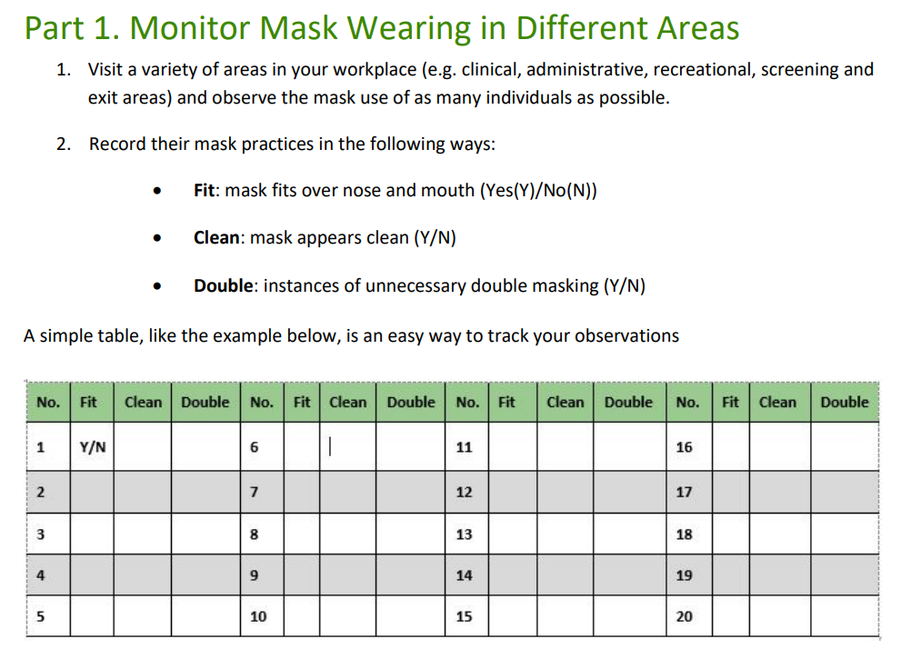
Assessing IPAC, continued
Public Health Ontario also has an activity worksheet that can be done at your work.
You can learn more about IPAC and these activities here: Action IPAC Activities Support IPAC Practices Congregate Living Settings¹⁰
Example activity:
Notes:
10. https://www.publichealthontario.ca/-/media/Documents/nCoV/cong/2022/08/ipac-activities-support-practices-congregate-living-settings.pdf?rev=a72c6dc272964d06a4654f9a55904a92&sc_lang=en&hash=85A33C145560CDA136137F1AFC2FEBD6

Slide 11
Assessing IPAC, continued
For more resources and support on infection prevention and control and its various facets, you can visit:
https://wellness-hub.ca/ipac/ipac-repository/¹¹
Notes:
11. https://wellness-hub.ca/ipac/ipac-repository/

Slide 12
Key Takeaways
Vaccine uptake* is only one part of being prepared for an outbreak.
Maintaining staff well-being and high IPAC standards are also important.
All three parts work together to help LTCHs and RHs reduce the number and severity of outbreaks.
*The focus of this course.

